Slide 1
The Fish-Penguin-Giraffe Algebra
A synthesis of zoology and algebra

Slide 2
Platonic Solids and Polyhedral Groups
Symmetry in the face of congruence

Slide 3
What is a platonic solid?
A polyhedron is three dimensional analogue to a polygon
A convex polyhedron all of whose faces are congruent
Plato proposed ideal form of classical elements constructed from regular polyhedrons

Slide 4
Examples of Platonic Solids
Five such solids exist:
  Tetrahedron
  Hexahedron
  Octahedron
  Dodecahedron
  Icosahedron
Why?
  Geometric reasons
  Topological reasons

Slide 5
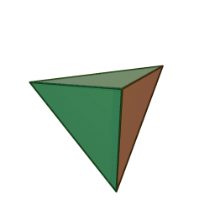
Tetrahedron
Faces are all equilateral triangles
4 vertices
6 edges
4 faces
Symmetry group: T_{d}

Slide 6
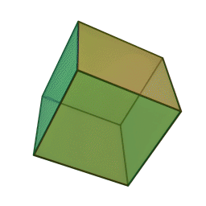
Hexahedron
Faces are all squares
8 vertices
12 edges
6 faces
Symmetry group: O_{h}

Slide 7
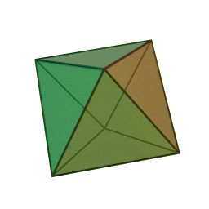
Octahedron
Faces are all equilateral triangles
6 vertices
12 edges
8 faces
Symmetry group: O_{h}

Slide 8
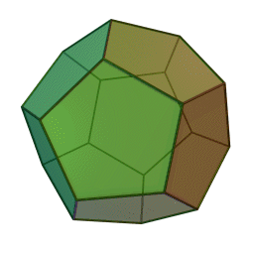
Dodecahedron
Faces are all pentagons
20 vertices
30 edges
12 faces
Symmetry group: I_{h}

Slide 9
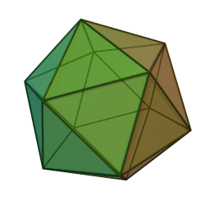
Icosahedron
Faces are all equilateral triangles
12 vertices
30 edges
20 faces
Symmetry group: I_{h}

Slide 10
Review of Plutonic Solids
 | Vertices | Edges | Faces | Symmetry Group
Tetrahedron | ₄ | ₆ | ₄ | T_{d}
Hexahedron | ₈ | ₁₂ | ₆ | O_{h}
Octahedron | ₆ | ₁₂ | ₈ | O_{h}
Dodecahedron | ₂₀ | ₃₀ | ₁₂ | I_{h}
Icosahedron | ₁₂ | ₃₀ | ₂₀ | I_{h}

Slide 11
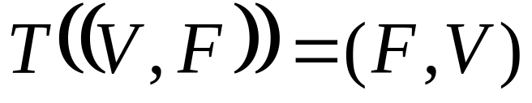
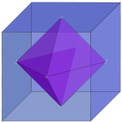
Dual Polyhedrons
Dual transformation T swaps vertices and faces
The dual of a platonic solid is another platonic solid
Ex: Dual of hexahedron is
octahedron
Point symmetry operations
leave faces and vertices
invariant

Slide 12
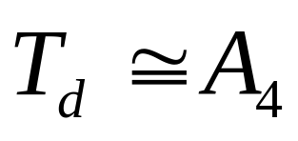
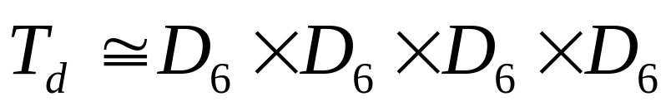
T_{d} Group (Tetrahedral Symmetry)
Non-Abelian group of order 24
Symmetry operations permute the vertices
Each face is invariant under dihedral-6 group operations
(Symmetry of other solids destroys this analogy)

Slide 13
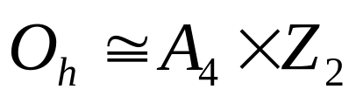
O_{h} Group (Octahedral Symmetry)
Non-Abelian group of order 48
Each face of the hexahedron is invariant under dihegral-8 group operations
Each face of the octahedron is invariant under dihedral-6 group operations
Dihedral operations on each face permute only half the vertices:

Slide 14
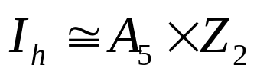
I_{h} Group (Icosahedral Symmetry)
Non-Abelian group of order 120
Each face of the dodecahedron is invariant under dihedral-10 group operations
Each face of the icosahedron is invariant under dihedral-6 group operations
Decomposition into alternating group:

Slide 15
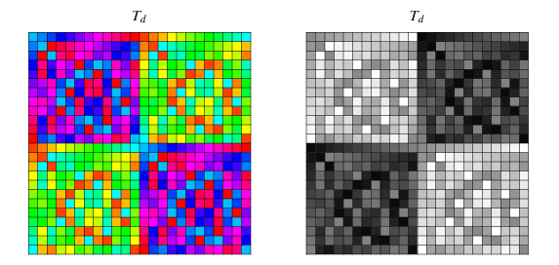
Applications
Patterning via Cayley tables

Slide 16
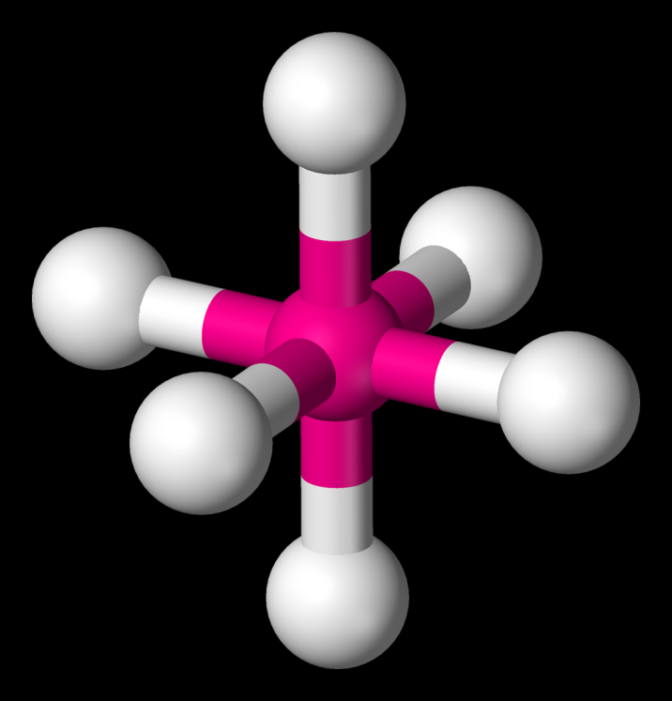
More
Molecular symmetries
Ex: SF6
  Hilarious gas

Slide 17
References
http://en.wikipedia.org/wiki/Platonic_solids
http://mathworld.wolfram.com/TetrahedralGroup.html
http://mathworld.wolfram.com/OctahedralGroup.html
http://mathworld.wolfram.com/IcosahedralGroup.html
http://en.wikipedia.org/wiki/Octahedral_group
http://en.wikipedia.org/wiki/Icosahedral_group
http://en.wikipedia.org/wiki/Tetrahedral_group
http://en.wikipedia.org/wiki/Dihedral_group#Notation
http://en.wikipedia.org/wiki/Octahedral_molecular_geometry

